Slide 1
Projected Population Analysis (2023)
An analysis of projected population data across different taluks

Slide 2
Introduction
This presentation provides an analysis of the projected population dataset for 2023, covering:
- Population distribution across taluks
- Gender-wise population trends
- Statistical insights and visualization
- Key findings and conclusions

Slide 3
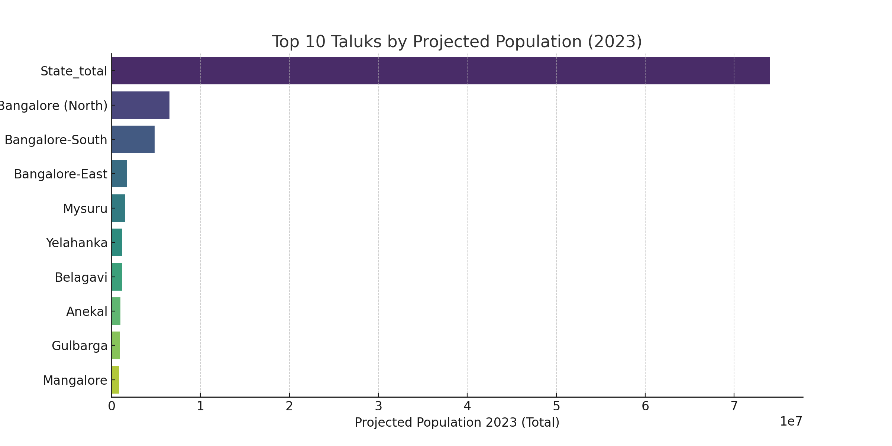
Top 10 Taluks by Projected Population (2023)
This bar chart represents the top 10 taluks with the highest projected population.
The variation in population highlights the dominance of certain taluks in terms of
population size.

Slide 4
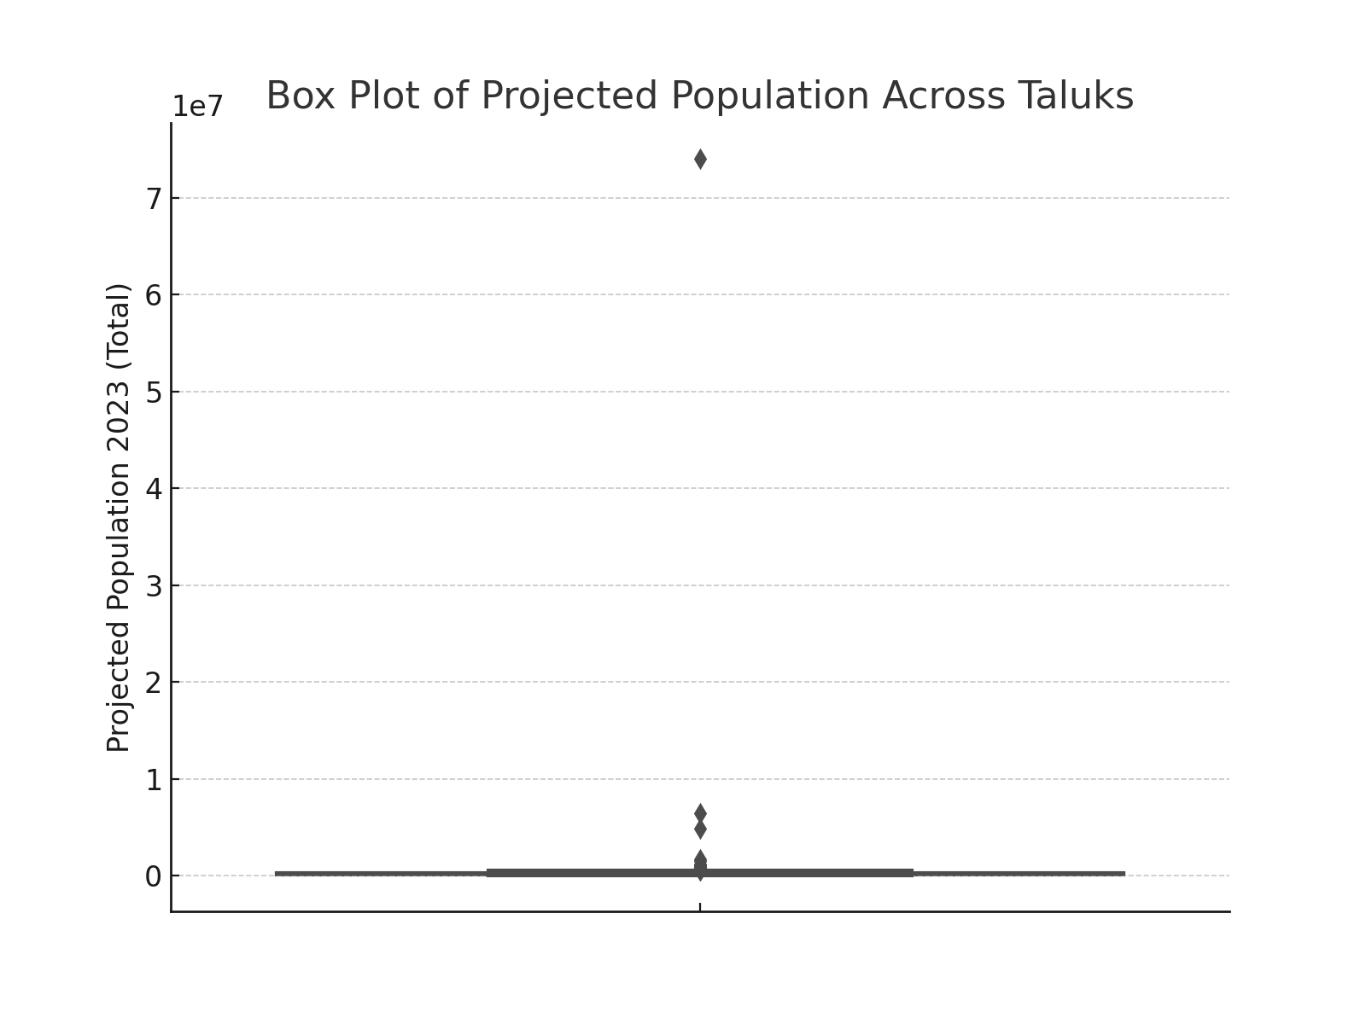
Box Plot of Projected Population
The box plot shows the distribution of projected population across different taluks.
It highlights the spread and possible outliers, indicating variations in population size.

Slide 5
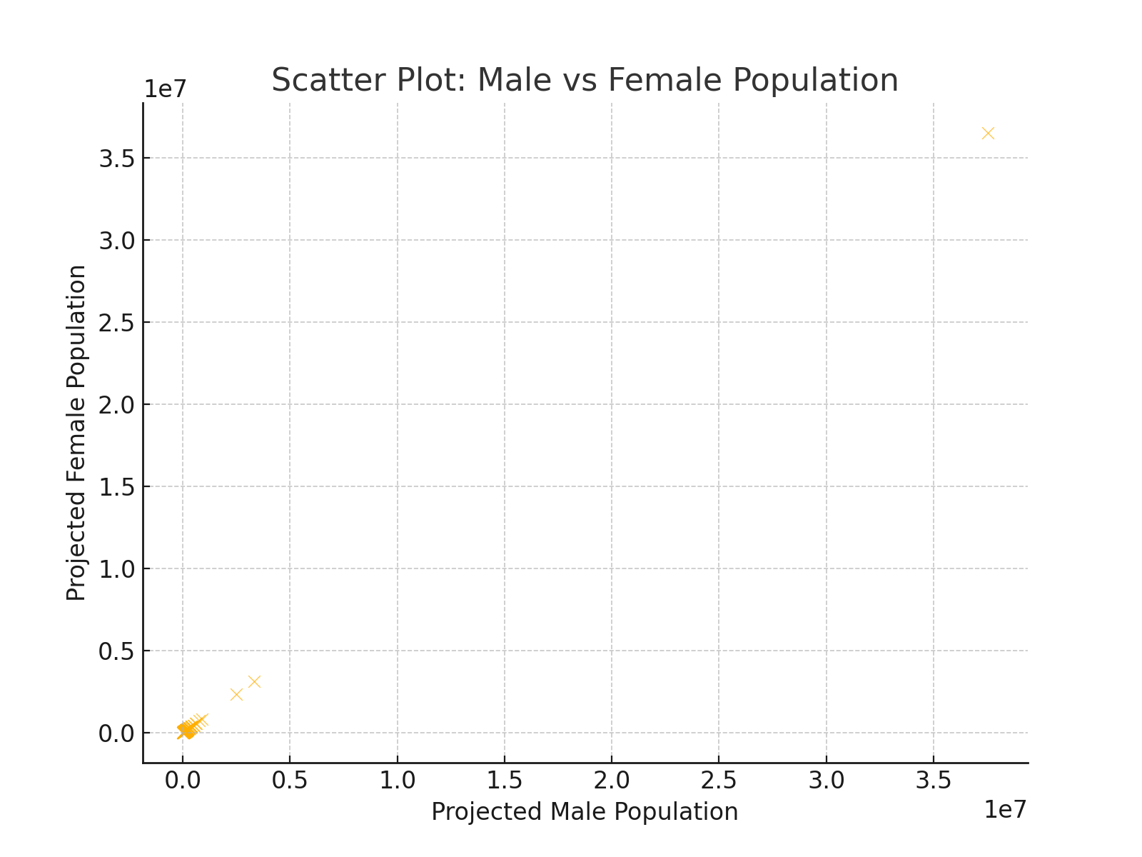
Scatter Plot: Male vs Female Population
This scatter plot visualizes the relationship between projected male and female
populations. The near-linear pattern suggests a balanced gender ratio across
different taluks.

Slide 6
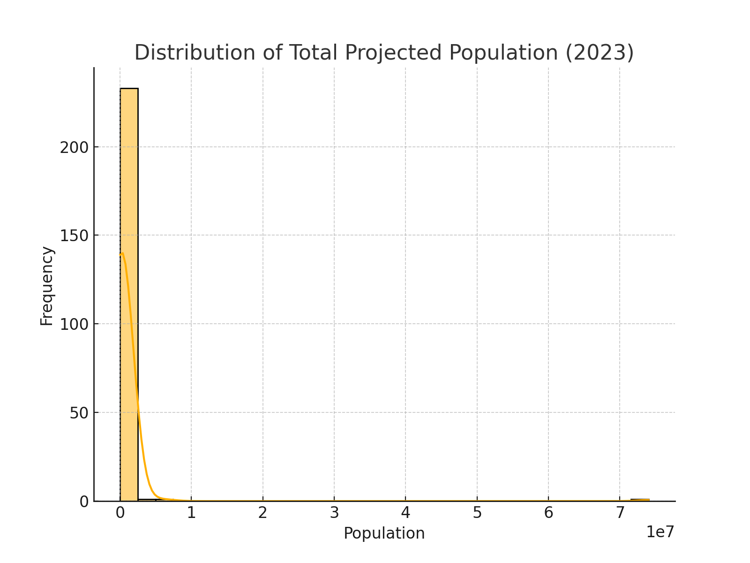
Distribution of Total Projected Population
The histogram depicts the frequency distribution of the total projected population
across taluks. It helps in understanding how populations are spread and whether
there are extreme values.

Slide 7
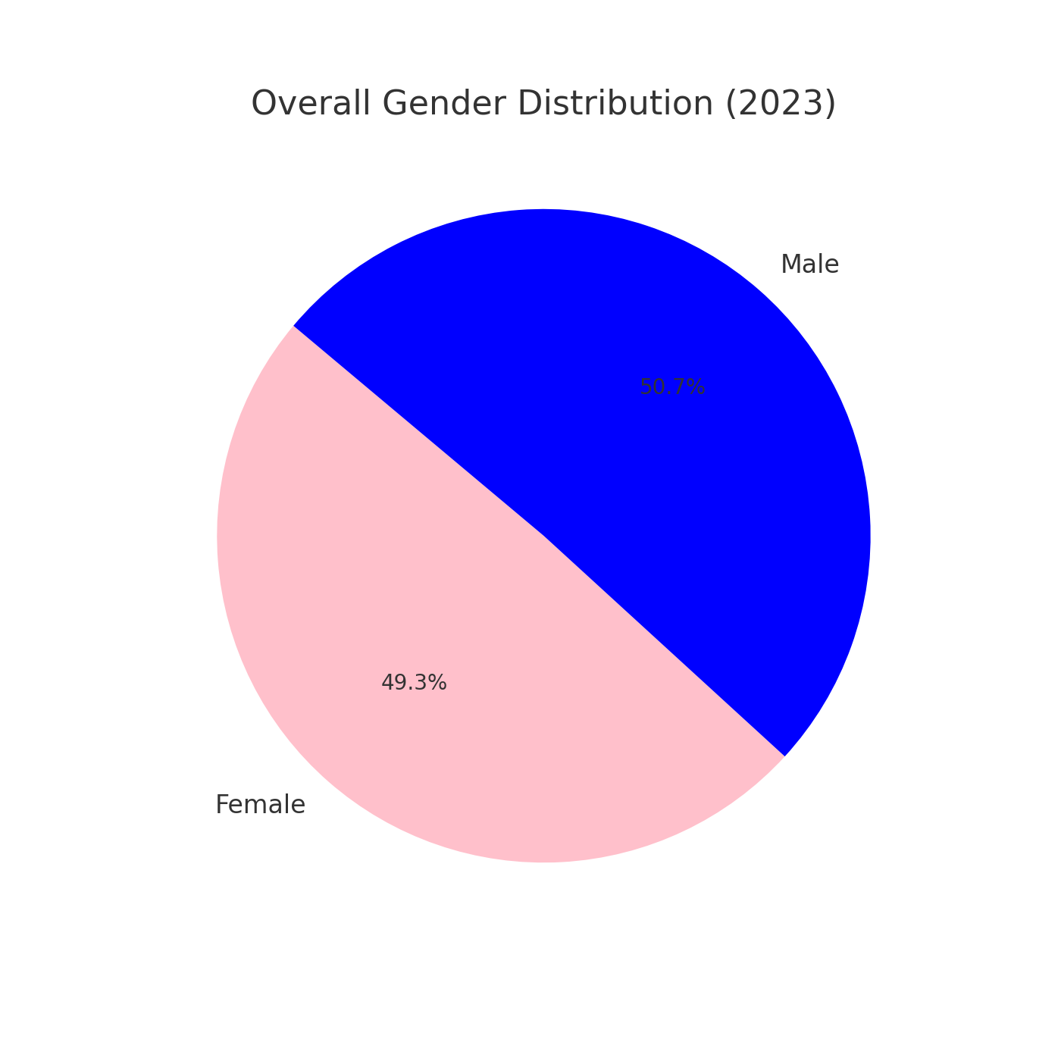
Overall Gender Distribution (2023)
This pie chart represents the overall gender distribution in the projected population. It confirms whether the male and female populations are approximately equal or show any disparity.

Slide 8
Conclusion
The analysis of projected population data provides insights into demographic trends.
Key findings include:
- Certain taluks have significantly higher populations.
- Gender distribution is relatively balanced across regions.
- The population distribution shows variability across different taluks.
These insights can aid in resource allocation and urban planning.

